Slide 1
Transform with Lenovo and VMware
Name
Date 2022

Slide 2
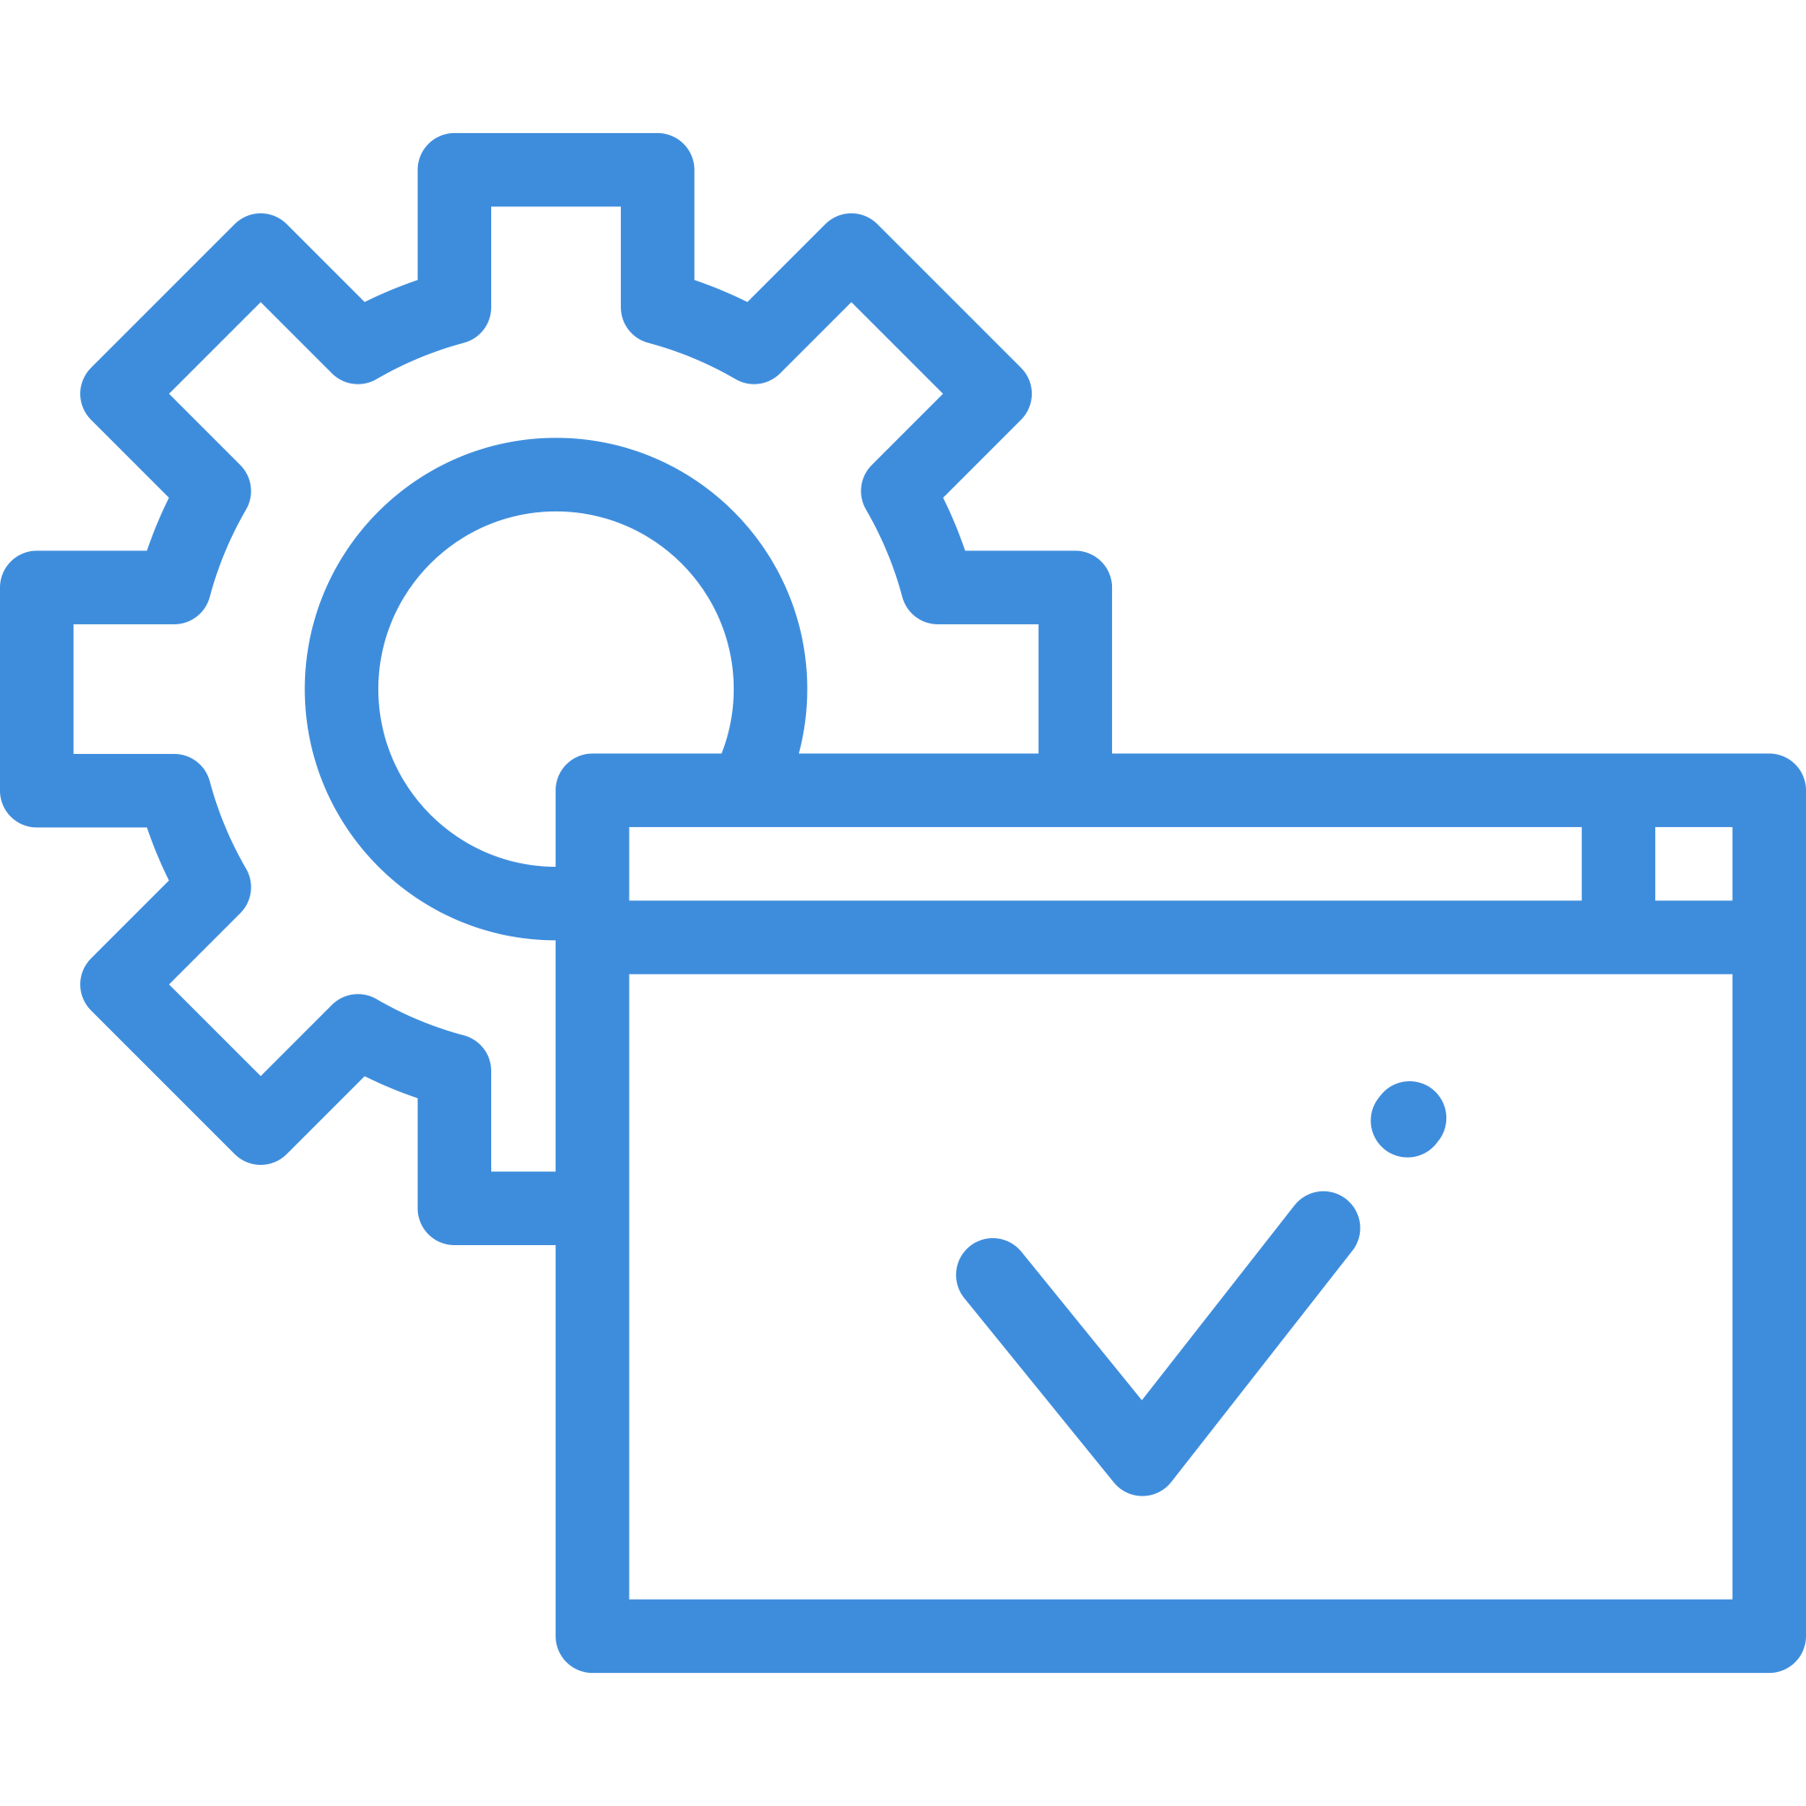
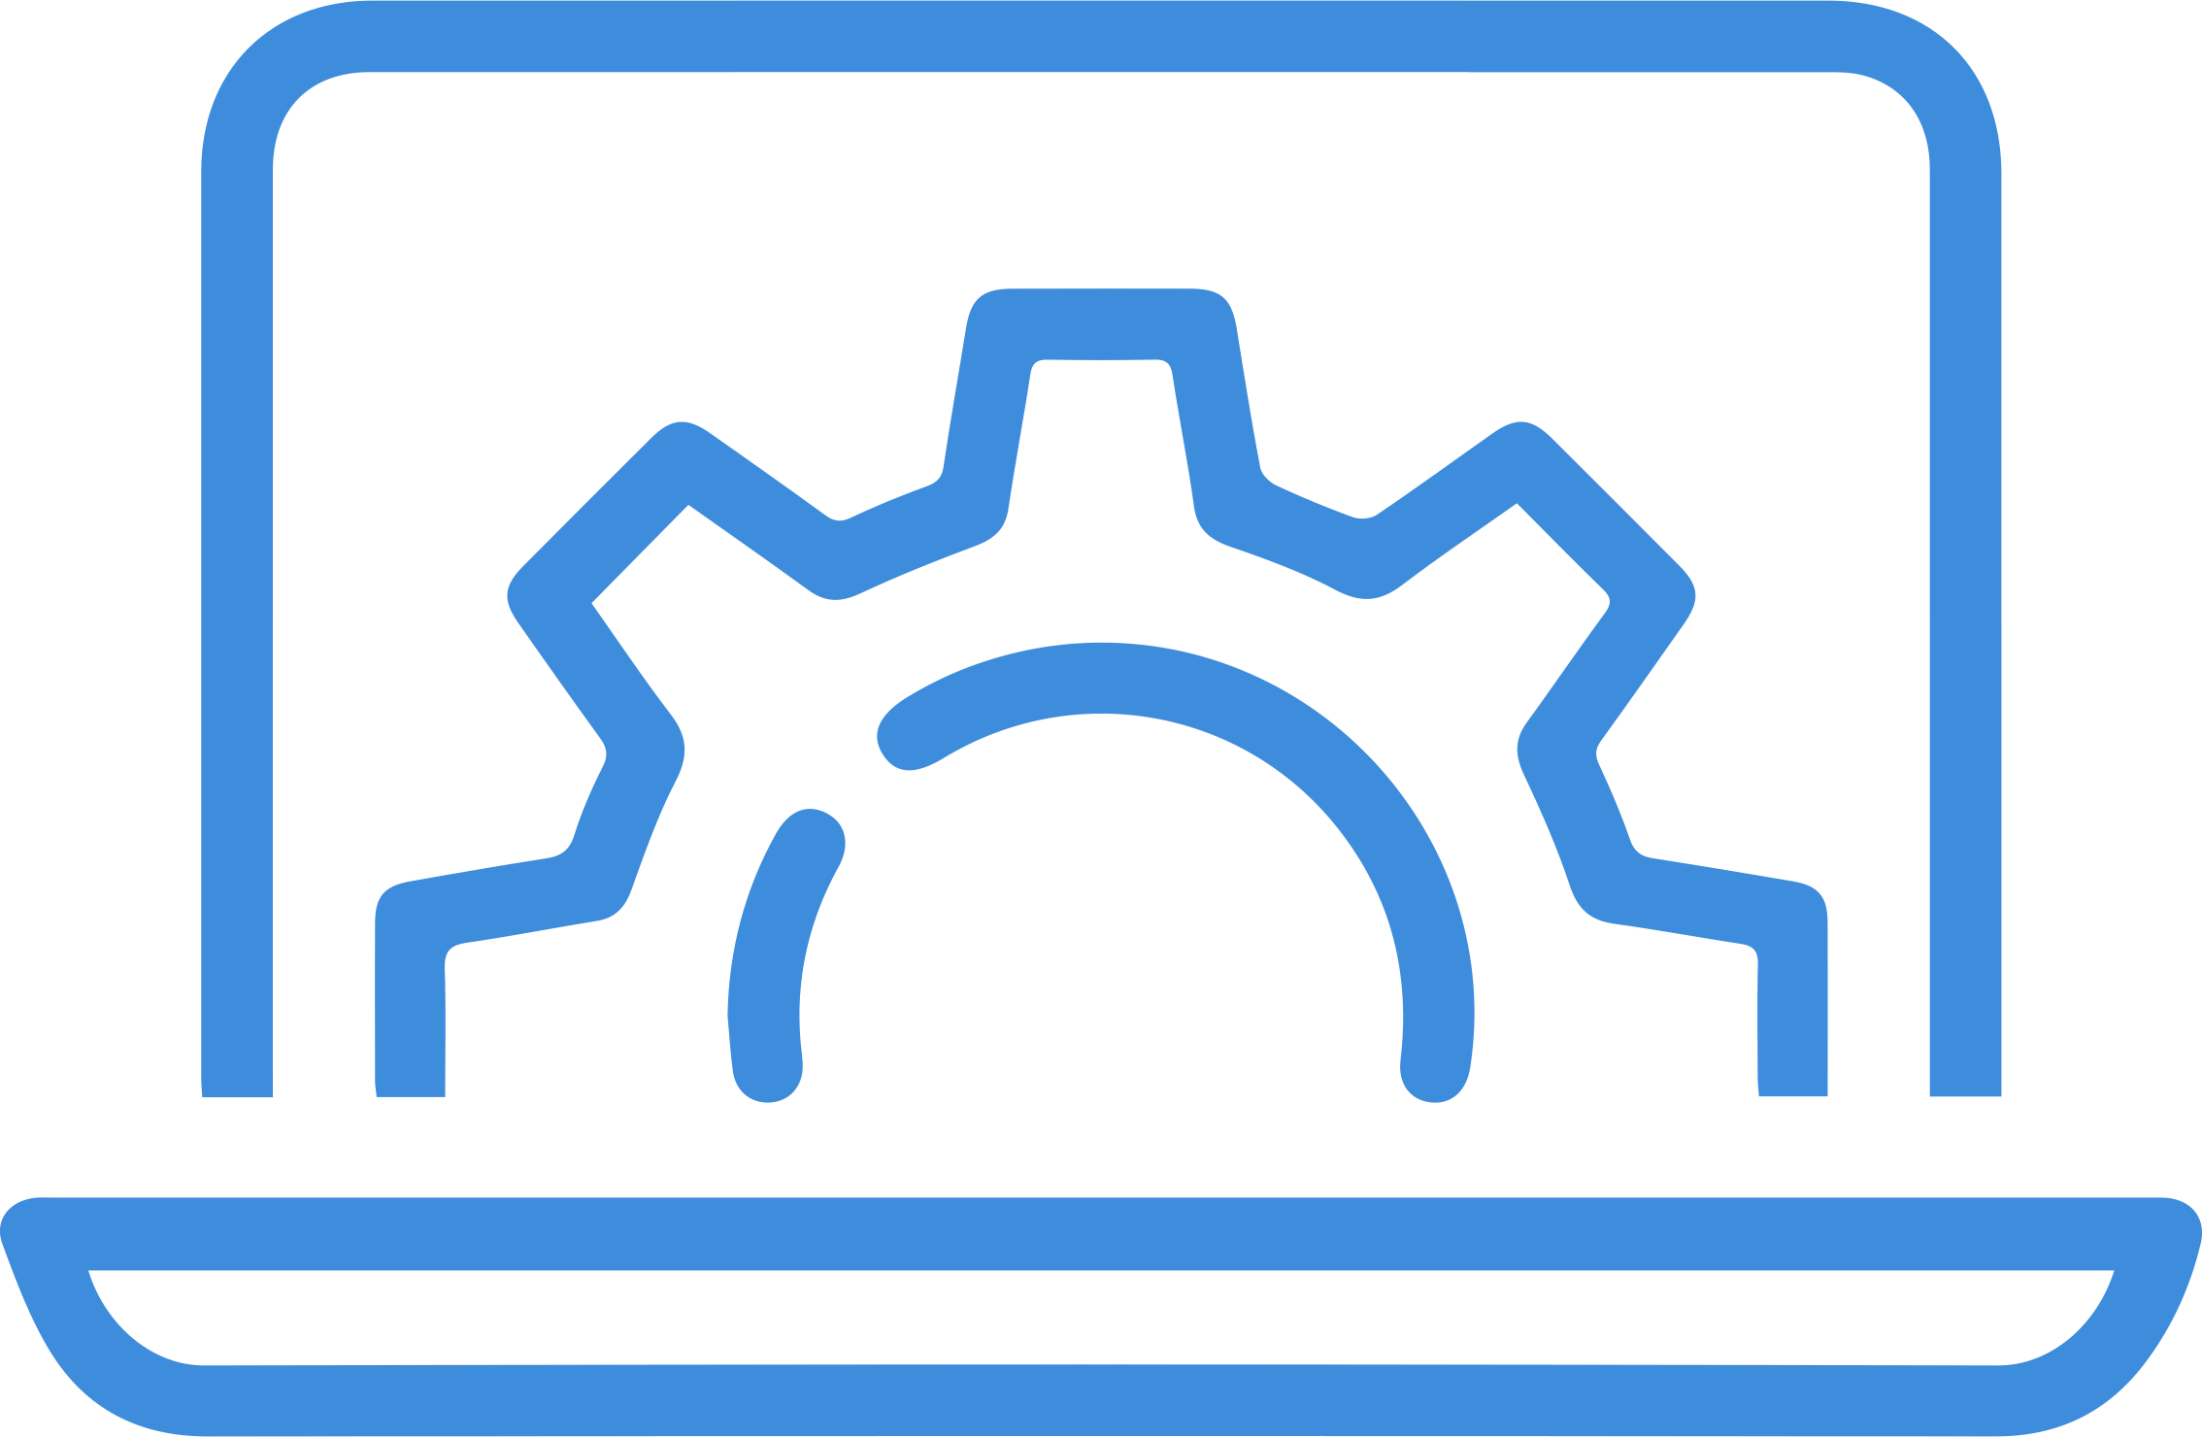

We’re solving today’s hard problems
80% of IT execs are increasing their investment in digital transformation¹
76% of app initiatives are focused on modernization²
Access to AI is a top priority for 83% of companies³
61% of CIOs struggle to manage a fragmented vendor ecosystem⁴
Notes:
Intent of slide: Showcase business trends and challenges to set up how Lenovo + VMware solutions will address them.
SOURCES:
1. VMware Executive Pulse, June 2021
2. VMware Market Insights study
3. MMC Ventures/Forbes
4. Lenovo global study of CIOs

Slide 3


20+ years doing digital transformation together
Winner of VMware’s 2021 Global Partner of the Year Award for Innovation
Winner of VMware's 2022 Partner Social Impact Award
Fully tested and verified infrastructure, software, and services
Notes:
Intent of slide: Present the Lenovo and VMware combined value prop

Slide 4
We deliver unique value
Accelerating the move from Cloud First to Cloud Smart
Unrivaled multi-cloud capabilities contain complexity and cost
Maximizing on-prem cloud economics from data center to edge to cloud
Making public and local cloud a seamless operating environment
Delivering more efficient management, cost-effective operations, faster application deployment
Notes:
Intent of slide: Discuss Lenovo and VMware’s partnership facts that bolster credibility for the success of the collaboration
---
Context to Cloud Smart: Cloud Smart is a Gartner strategy proposal. The dynamic nature of cloud requires organizations to shift their approach from cloud-first, which prioritizes cloud adoption and legacy modernization above other considerations, to cloud-smart, which balances cloud adoption with the organization’s unique circumstances, goals and business value. By 2025, more than 60% of organizations that have adopted a cloud-first strategy will replace it with a cloud-smart strategy (source Gartner).

Slide 5
What are our customers challenged by?
Notes:
---

Slide 6

Getting the flexibility of the cloud on premise
CHALLENGES
Overprovisioning infrastructure
Accommodating growth
Labor shortages
WE DELIVER
Pay-as-you-go model
Modernize and scale without incremental capital investments
Solutions to streamline IT and simplify management
Notes:
Intent of slide: Showcase how Lenovo and VMware as a service solutions simplify the procurement, deployment, and management of modern IT infrastructures.
--
Enterprise customers can now benefit from a fully managed as-a-Service hybrid cloud for running their business applications in a consumption-based price model. Gives mid-market SMBs the ability to modernize, as it is more cost-friendly to purchase Lenovo HCI as a service. They can more easily meet evolving needs and always be ready for peak business performance and growth. This provides the simplicity and flexibility of the cloud with infrastructure on-premises. TruScale simplifies the procurement, deployment, and management of modern IT infrastructures. It gives customers the ability to drive growth and gain competitive advantage

Slide 7

Incorporating edge computing
CHALLENGES
Limited infrastructure and access Maintaining security
Unique environments and requirements
WE DELIVER
A portfolio of devices, optimized indoor antennas, and wireless options
Enterprise data protection at the edge
Hardware built to handle extreme conditions
Notes:
Intent of slide: Set-up what’s hard about edge computing
--
VMware multi-cloud accelerates innovation with cloud capabilities and modern architectures. Lenovo makes the only infrastructure designed for the edge. This is the only true edge compute stack validated on Lenovo hardware with sophisticated network validations. The VMware edge compute stack on Lenovo ThinkEdge SE350 allows users to seamlessly extend their VMware environment from the datacenter to the edge. Security and connectivity are top concerns. Edge computing is often deployed without thinking through the security implication. These solutions are built with security in mind to ensure that critical data is protected. The server might also be exposed to serious climate challenges, vibrations, and data breaches. Locations may have more limited infrastructures and limited access into higher speed network connections because of their geographical location. Lenovo’s hardware is built to handle those conditions. Outcomes Customers get high availability of the data stored at each edge location. Retail, manufacturing, healthcare, smart cities, and many more can benefit from resilient edge computing that extends the VMware environment out from the core data center.

Slide 8

Unlocking AI for the enterprise
CHALLENGES
Deployment cost and building business case
Bringing AI into the real world
Achieving required AI performance
WE DELIVER
AI-ready infrastructure your existing workloads and next gen apps
Optimized and pre-validated AI solutions
Near bare-metal performance across multiple nodes
Notes:
Intent of slide: Showcase how Lenovo and VMware analytics and AI solutions help organizations boost AI performance
--
VMware vSphere optimizes performance, increases availability, tightens security, streamlines maintenance, and reduces costs to create an agile, efficient, resilient and intrinsically secure infrastructure platform that supports existing workloads and next-gen applications. Lenovo XClarity Administrator ramps up and scales infrastructure provisioning and maintenance. It serves as a central integration point to extend the data center management processes to physical IT. Going from proof of concept to enterprise deployments requires effective scaling—through efficient use of resources to ensure manageability and availability—and infrastructure cost management. These solutions unlock AI for every enterprise

Slide 9
How can we help accelerate your transformation?
Notes:
---

Slide 10
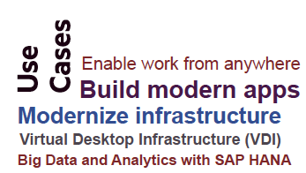
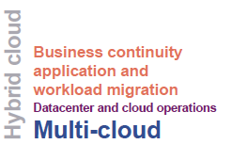
Accelerate your cloud journey
Our solutions help you
Scale cloud-native platform operations to achieve enterprise cloud transformation
Eliminate dependencies on inefficient silos of infrastructure, bringing all clouds and workloads together
Migrate workloads or replace failing components without incurring downtime
Notes:
Intent of slide: Discuss how cloud smart helps customers move from cloud first to cloud smart --- Multi-cloud is the digital business environment for today and tomorrow, as businesses move from a ‘cloud first’ mandate to a ‘cloud smart’ strategy for workloads and data. At Lenovo, we offer the expertise to design the best hybrid or multi-cloud strategy, with secure and rapid data migration, coupled with the economics and flexibility of managing everything-as-a-service. This managed services approach along the end-to-end cloud lifecycle helps customers confidently accelerate their cloud transformation. Lenovo offers the broadest choice of ready-to-deploy cloud infrastructure solutions running on the industry’s most reliable server platform (recognized eight years in a row). With end-to-end lifecycle managed services, intelligent, fast data migration, and robust data management, Lenovo builds-in optimization, and tuning scenarios for any workload. VMware Cloud Foundation provides a future-proof hybrid cloud platform built on full stack hyperconverged infrastructure. VCF provides a complete set of secure software-defined services for compute, storage, network security, Kubernetes management, and cloud management. The result is an agile, reliable and efficient cloud solution that offers consistent infrastructure and operations across private and public clouds

Slide 11
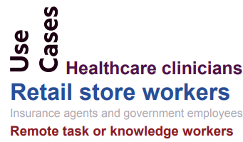
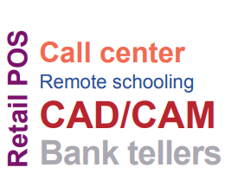
Support an agile and remote workforce
Our solutions help you
Allow IT teams to shift to a cloud operating model for faster, lower cost, reduced risk
Software-defined intelligence for more efficient workloads
Achieve virtualization through familiar tools and processes
Improve availability of applications and data accessibility on multiple devices
Notes:
Intent of slide: Discuss how Lenovo and VMware remote work solutions support the state of work that’s here to stay. Remote work is here to stay. Companies have found that employees have been productive during the pandemic and thus are more likely to continue supporting remote work. Companies are also realizing they can achieve real estate savings if they allow a percentage of their employees to work remotely. We support an unbeatable range of virtual desktop and virtual application scenarios—all using industry-proven Lenovo hardware combined with software from VMware. Fully tested across applications, software, hardware, and services, built to streamline IT administration, and proven to simplify the transition to a virtual desktop infrastructure

Slide 12
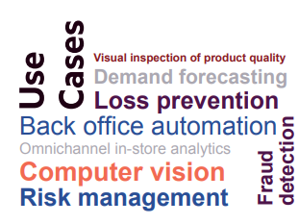
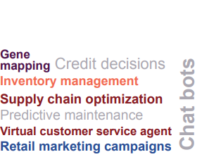
Get an AI-ready platform for any size deployment
Our solutions help you
Simplify management of modern and on-premises apps
Reduce security risk of pushing data to the cloud
Offer the power needed for AI workloads while optimizing performance and cost
With the full range from inference to training, from edge to core, and from high end to edge environments
Notes:
Intent of slide: Discuss how Lenovo and VMware’s AI platform provides improved workload performance
Our solution is an AI-ready enterprise platform for any size deployment. Based on Lenovo high performance systems with VMware vSphere and NVIDIA AI Enterprise software and GPUs, the solution provides improved performance for AI modeling. The solution is scalable and supports multiple work streams with load balancing and live migration. Lenovo is unique in this space because they have the broadest portfolio from gateways to datacenter platforms. The company has unique products like Lenovo SR670V2, a server device with acceleration hardware designed for AI/ML workloads. At the edge, Lenovo has unique designs with Lenovo SU350 and Lenovo 450 with Edge AI and has the smallest footprint for enterprise GPU.

Slide 13
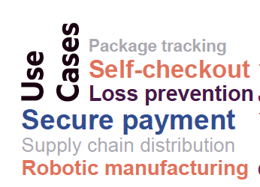
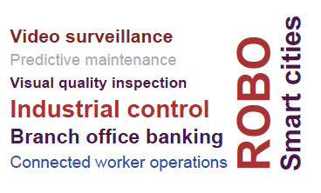
Enable transformation from the data center to the edge
Our solutions help you
Easily deploy edge computing with a ‘fit anywhere’ form factor
Extend the VMware environment out from the core data center
Protect and connect data that drives business outcomes
Maximize performance and optimize user experiences
Notes:
Intent of slide: Discuss how Lenovo and VMware’s edge solutions offer a secure, scalable, and high-performing edge experience
Our edge platform extends data center efficiencies of HCI and gives customers the ability to run cloud-native, Kubernetes applications at the edge (via Tanzu). This solution simplifies networking,
eliminates the need for external network devices at the edge, and powers seamless operations. Combining Lenovo’s powerful purpose-built edge hardware with VMware’s software stack saves time and money while connecting data and lowering risk.

Slide 14
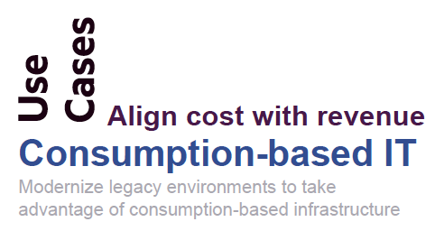
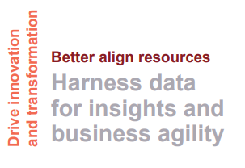
Better manage your data and infrastructure
Our solutions help you
Efficiently scale data management solutions and enterprise apps to lower operational costs
Scale business quickly without relying on complex IT procedures
Move workloads to optimize performance and resource utilization
With 24/7 proactive monitoring, management, and service
Notes:
Intent of slide: Showcase how Lenovo and VMware as a service solutions give customers greater control while keeping them current and resilient. We’re customer-centric and focused on outcomes and the end-user experience to deliver customer expectations. People aren’t buying the box, they’re buying the hybrid cloud to drive transformation. TruScale is an umbrella for all as-a-service Lenovo solutions leveraging the full Lenovo portfolio from pocket to data center to cloud. “If we can sell it, we can ‘TruScale it”. With TruScale IaaS, customers get an on-premises, pay-as you-use data center with full flexibility, full maintenance, support, and management, plus real-time transparency to usage and costs. Offering both aaS and managed options with additional support keeps customers current and resilient

Slide 15
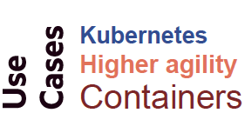
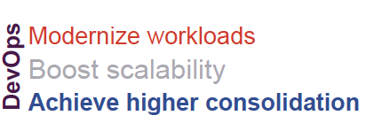
Enable modernized workloads and boost performance
Our solutions help you
Bridge the gap between IT Operations and developers
Connect and protect apps and data across the Kubernetes estate
Scale out to meet changing performance and capacity requirements
Deploy memory-intensive and AI workloads seamlessly
Notes:
Intent of slide: Discuss how Tanzu offers a modular cloud native application platform that both drives efficient, scalable cloud native operations.
VMware Tanzu offers a modular cloud native application platform that both drives efficient, scalable cloud native operations and streamlines the developer experience to speed applications to production. Organizations can access a multi-cloud Kubernetes runtime in VMware vSphere with Tanzu, enabling them to run new containerized applications alongside existing applications. Lenovo and VMware share a common vision of delivering an invisible infrastructure that does not demand significant time and resources to deploy and maintain. They have had a long relationships in joint development partnership to address a global customer base. This frees IT to focus on delivering applications and drive innovation, greater efficiency, and agility for their business. Lenovo and VMware solutions together address the enterprise’s goal of building, running, managing, connecting, and protecting any app on any cloud and across clouds
UTILIZING OUR VARIED THINKAGILE VX PORTFOLIO OFFERINGS FOR VMWARE

Slide 16
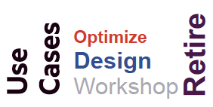
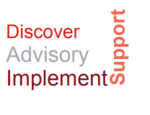
Bridge the gap between teams, tools, and processes
Our solutions help you
De-risk the journey in using new technology with proven best practices
Get your investment working for you quickly with minimal disruption to your staff
Troubleshoot problems faster with managed services
Move the responsibility for infrastructure support from your IT team to Lenovo
Notes:
Intent of slide: Showcase how Professional Services gives customers a faster time to value
Professional services and managed services from Lenovo give customers a faster time to value and frees up teams to focus on other initiatives. This bridges the gap between teams, tools, and processes. Advisory and implementation services such as assessment, health check, design, implementation, upgrade, and migration on virtualization solutions in VMware also ensure that customers get the most out of the solutions they invest in. These offerings work to provide support and services that are unique to the business. This gives customers peace of mind that they are backed up by the resources they need and will keep running no matter what

Slide 17
What outcomes do we deliver?
Notes:
---

Slide 18

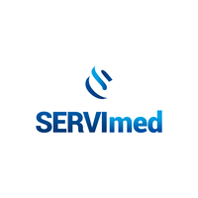
Simplify IT across the organization
Infrastructure services that align with business needs
“Working with Lenovo TruScale Infrastructure Services, we can precisely match resources to business requirements, so that we can act on business opportunities but don't pay for idle capacity.”
Henrique Cardoso, Coordinator of IT Infrastructure and Security, SERVImed
Notes:
Intent of slide: Use Servimed to demonstrate how Lenovo offers infrastructure services to boost productivity and unlock new IT efficiencies.
CHALLENGE As SERVImed prepared to upgrade to SAP HANA applications, a large, efficiency-boosting opportunity presented itself in their underlying IT infrastructure. At the time, their legacy IT solution required specialized support which increased cost and limited agility. SOLUTION SERVImed transformed their system and scaled up the infrastructure to meet growing business needs. From hardware design to implementation and service management, TruScale made it possible for SERVImed to do this quickly and smoothly.
https://www.lenovo.com/us/en/servers-storage/solutions/customer-stories/servimed/?orgRef=https%253A%252F%252Fwww.google.com%252F

Slide 19


Gain control of on-premises IT infrastructure
Pay-as-you-use data center with full flexibility
“The strong integration between Lenovo and VMware is a big plus for us. It makes it easy for us to set up and manage the environment. We can also count on the platform to deliver the high performance and reliability that our business demands.”
Espen Riis Andersen, Head of Server Hardware, Basefarm
Notes:
Intent of slide: Use Basefarm to demonstrate how Lenovo and VMware as a service offers can help organizations meet needs for cost-effective performance, reliability, and availability.
CHALLENGE Basefarm needed to scale up data center resources to meet the demand. The company looked for an infrastructure partner that could meet its needs for cost-effective performance, reliability, and availability. RESULTS With Lenovo and VMware vSAN technology delivering high availability and stability, Basefarm can ensure predictable performance and maximum uptime for its clients. Alongside this, the company benefits from rapid time to-production for new systems, thanks to the easy configuration and management. SOLUTION Basefarm introduced Lenovo ThinkEdge servers to its data center. After thoroughly testing the hardware for build quality and performance, the ThinkEdge servers passed with flying colors. The company also worked with Lenovo to establish a VMware vSAN™ hyperconverged architecture using Lenovo ThinkAgile VX Series appliances.

Slide 20


Future-proof IT with HCI solutions
Achieve a consolidated pool of resources by leveraging virtualization technology
Houston Methodist Hospital consolidated rack space and decreased cost on server infrastructure with fewer people Management and infrastructure annually now cost 20% less
Notes:
Intent of slide: Teaming up to achieve a consolidated pool of resources by leveraging virtualization technology. Move from 3 Tier to HCI
Background: Consolidated Rackspace and lowered cost on Server Infrastructure with less people. They were
able to move into CoLo and move from 12 racks to 4. Reduce Management and Infrastructure
Annual Cost by 20%

Slide 21


Make the work environment more effective
Accelerate time to user access and cut costs
“Now our school can provide cutting-edge digital services to both teachers and students. We are now running highly demanding applications such as Autodesk AutoCAD and Autodesk Fusion 360 smoothly in virtual desktop environments, contributing to better experiences for our learners.”
Margherita Rabaglia Head Teacher, Istituto di Istruzione Superiore C. E. Gadda
Notes:
Intent of slide: Use Gradient to demonstrate how Lenovo and VMware remote work solutions can help organizations simplify the transition to VDI, achieve efficiency, and cut costs.
CHALLENGE Gradient wanted to significantly reduce IT cost and complexity, enhance the reliability of services, accelerate the deployment of updates and new applications, and simplify remote access with VDI. Recognizing that desktop virtualization could solve its immediate issues, as well as making geographic expansion faster and easier in the future, Gradient identified VMware as its preferred provider of virtualization technology. RESULTS Thanks to its VDI solution from Lenovo and VMware, costs on calls and infrastructure have been reduced. Gradient estimates that it will achieve savings of approximately 40% over 10 years. SOLUTION As a certified integrated solution, or VMware vSAN ReadyNode™, the ThinkEdge SR630 is delivered fully assembled and tested with VMware Horizon, VMware vSphere and VMware vSAN, and its onboard SSD storage eliminates the need for a separate storage array, saving money while accelerating storage operations.

Slide 22
Why Lenovo and VMware?
Notes:
---
Intent of slide: Discuss Lenovo and VMware’s partnership facts that bolster credibility for the success of the collaboration

Slide 23

We deliver an invisible infrastructure that doesn't demand significant resources to deploy and maintain
We help you build, run, manage, connect, and protect infrastructure and any app on-premises and on any cloud and across clouds
All to streamline IT Operations and speed business innovation
Notes:
Intent of slide: Close with a final value prop and the value of Lenovo + VMware

Slide 24
Let us help accelerate your journey to multi-cloud

